Slide 1

More switch statement
In the last video, we looked at the switch statement, and how we can use it, instead of an if statement, if all our test conditions are testing a single variable's state.
The switch statement has seen quite a few updates through the years.
So in this video, I'm going to explore some of the new features of the switch statement.
I'll be looking at a couple of these now, and reviewing others a bit later in the course, that require some knowledge of classes and object-oriented programming.
COMPLETE JAVA MASTERCLASS
More switch statement

Slide 2
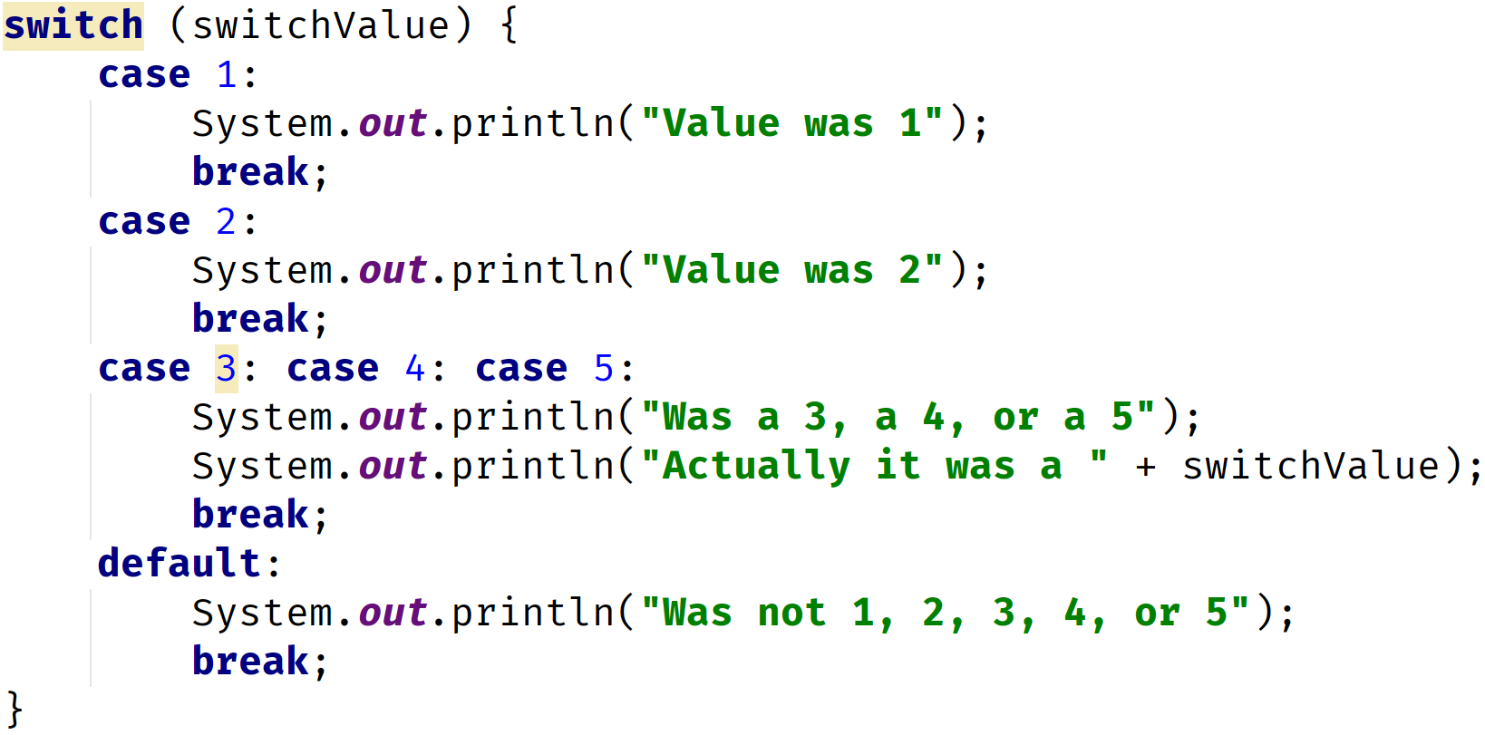
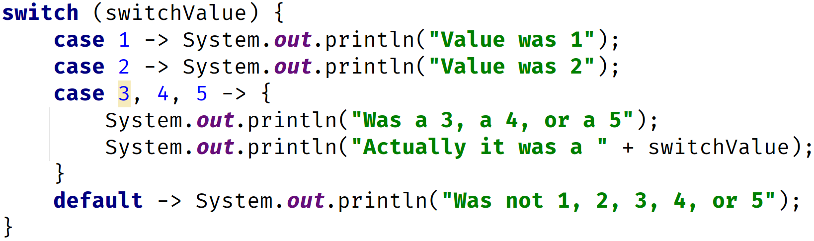
Traditional Switch Statement vs. Enhanced Switch Statement
Traditional Switch Statement | Enhanced Switch Statement
COMPLETE JAVA MASTERCLASS
More switch statement

Slide 3
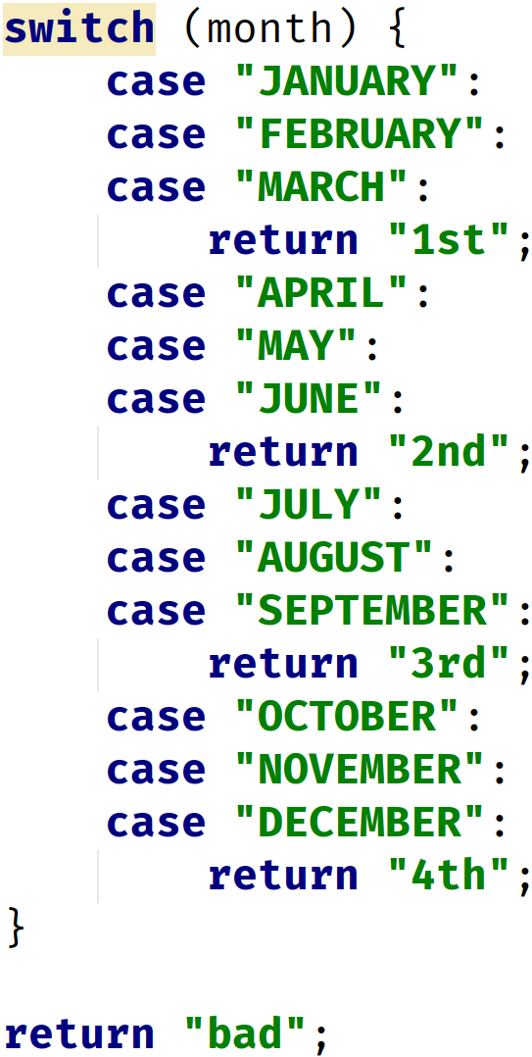
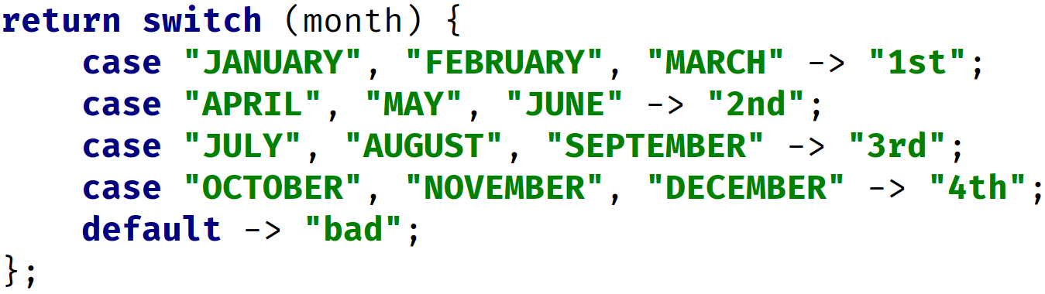
Traditional Switch Statement vs. Enhanced Switch Expression
Traditional Switch Statement used in a method, returning values | Enhanced Switch Expression
COMPLETE JAVA MASTERCLASS
More switch statement

Slide 4


When to use yield in a switch
Your switch statement is being used as a switch expression returning a value.
Your case label uses a code block, with opening and closing curly braces.
This code | is implicitly translated to
COMPLETE JAVA MASTERCLASS
More switch statement

